Slide 1
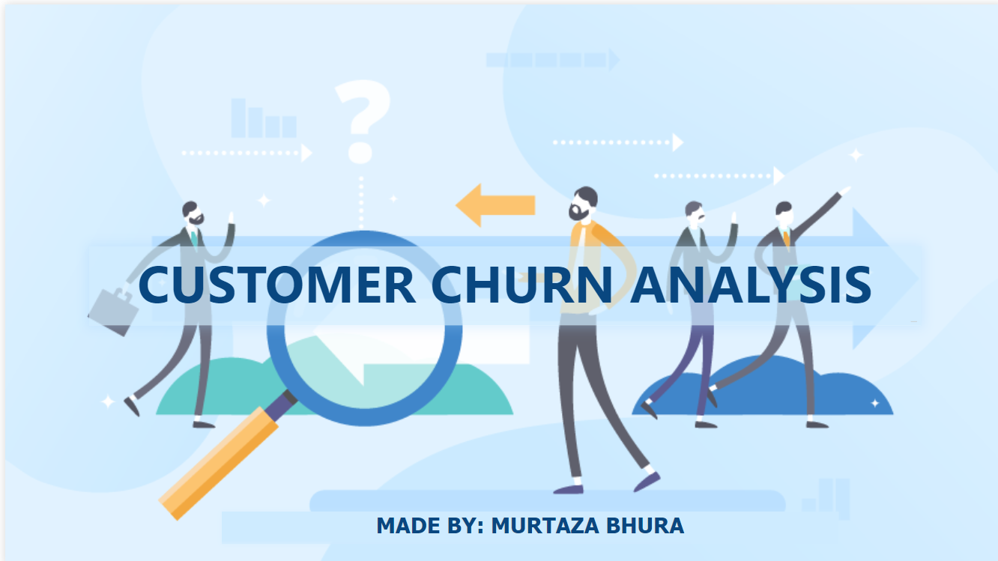

Slide 2
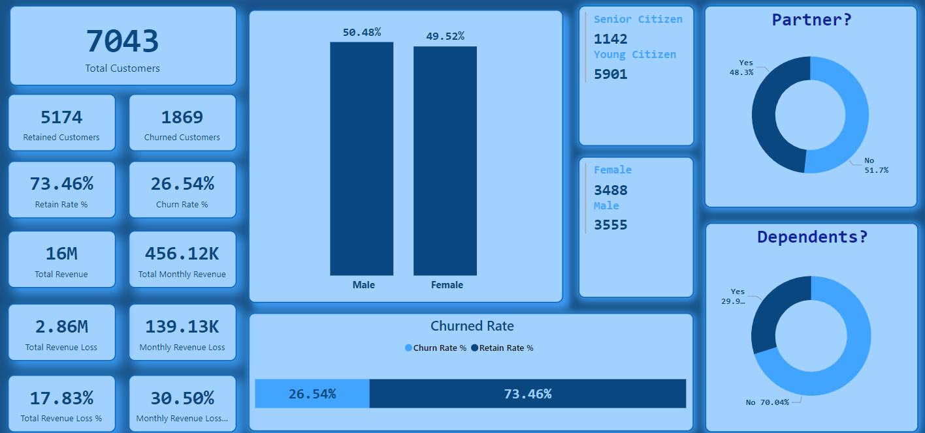
CUSTOMER DEMOGRAPHICS

Slide 3
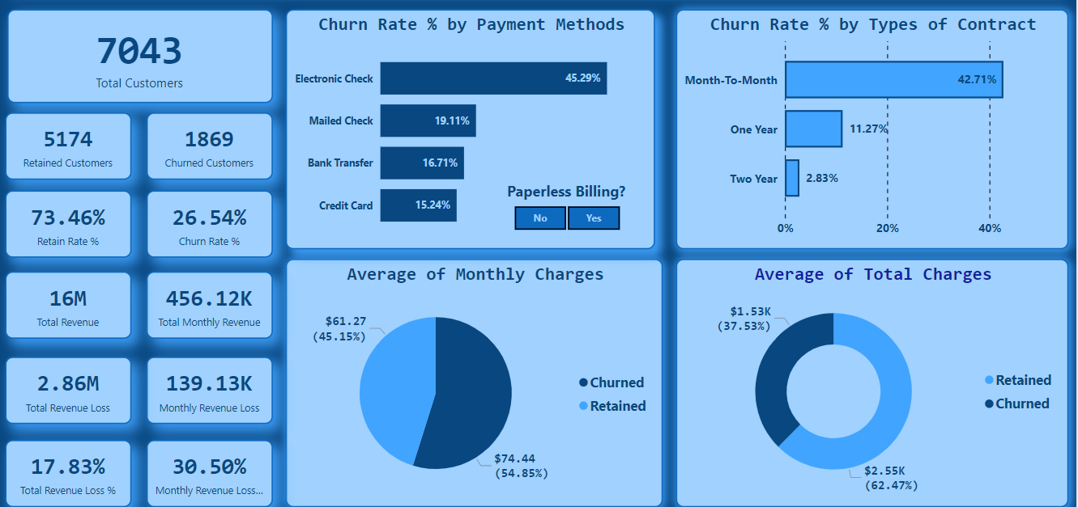
ACCOUNT DETAILS

Slide 4
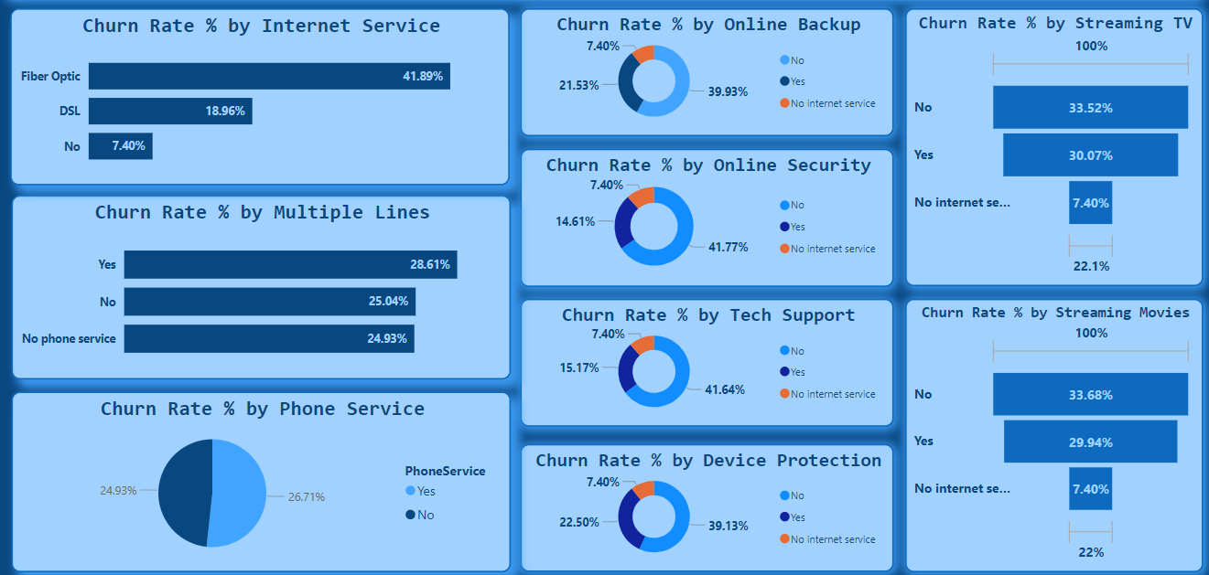
SUBSCRIPTION DETAILS

